Slide 1
PL/SQL Basics

Slide 2
Objectives
At the end of this session, you will be able to:
    Understand the PL/SQL Block terminology and features of PL/SQL
    Use various PL/SQL types, variables and subtypes
    Use SQL statements inside PL/SQL Block
    Use various PL/SQL control structures
    Write and execute anonymous & named blocks

Slide 3
Agenda
Introduction to PL/SQL
PL/SQL block structure
Anonymous PL/SQL Block
Variables, assignments, and operators
Using SQL in PL/SQL
Control structures
  Conditional structures
  Iterative structures

Slide 4
About SQL
The purpose of SQL is to provide an interface to a relational database such as Oracle Database, and all SQL statements are instructions to the database.
The strengths of SQL provide benefits for all types of users, including application programmers, database administrators, managers, and end users.
Notes:
SQL has become the standard database language because it is flexible, powerful, and easy to learn. A few English-like commands such as SELECT, INSERT, UPDATE, and DELETE make it easy to manipulate the data stored in a relational database.
The purpose of SQL is to provide an interface to a relational database such as Oracle Database, and all SQL statements are instructions to the database.
The strengths of SQL provide benefits for all types of users, including application programmers, database administrators, managers, and end users.
Now you must be wondering why we require PLSQL, while SQL is already exists.

Slide 5

Why PLSQL
Now you must be having few questions in mind
If SQL is so powerful, why we require to use PL/SQL?
Let us think about few scenarios…

Slide 6

Why PL/SQL?
How can we have a chain of SQL statements which produce result according to the output of previous queries?
How can we take any smart decisions based on users input or based on output on previous queries..?
How can we automate any task using SQL?
Notes:
If so, then I have few questions for you..
How can we have a chain of SQL statements which produce result according to the output of previous queries?
How can we take any smart decisions based on users input or based on output on previous queries..?
How can we automate any task using SQL?
Can we accomplish these tasks in SQL?
Answer is NO.
SQL is a very powerful, set-oriented language whose sole purpose is to manipulate the contents of relational databases.
If you write applications built on Oracle Database, you must be executing SQL statements to retrieve data from or change data in that database. Yet SQL cannot be used to implement all business logic and end-user functionality needed in our applications. That brings us to PL/SQL.
PL/SQL offers a set of procedural commands like IF statements, loops, assignments, etc
PL/SQL commands are organized within blocks, that complement and extend the reach of SQL.
It is certainly possible to build applications on top of SQL and Oracle Database without using PL/SQL.
But Utilizing PL/SQL to perform database-specific operations, most notably SQL statement execution, offers several advantages, though, including tight integration with SQL, improved performance through reduced network traffic, and portability.

Slide 7

Introduction
The PL/SQL programming language was developed by Oracle Corporation in the late 1980s as procedural extension language for SQL and the Oracle relational database.
PL/SQL, supplement SQL with standard programming-language features like:
    Block (modular) structure
    Flow-control statements and loops
    Variables, constants, and types
    Structured data
    Customized error handling
PL/SQL is available in Oracle Database
(since version 7)
Notes:
What is PL/SQL?
The PL/SQL programming language was developed by Oracle Corporation in the late 1980s as procedural extension language for SQL and the Oracle relational database.
PL/SQL is a combination of SQL along with the procedural features of programming languages.
Let's start at the beginning and take a look at what Procedural Language/Structured Query Language (PL/SQL) really is, what it is good for, and how it fits into the world of programming.
In order to understand definition of PLSQL, You must know
What a computer "language" is
What "procedural" means in this context
What is Structured Query Language
And The idea of a language "extension"
Let's look at each concept in turn.
A computer language is a particular way of giving instructions to (that is, programming) a computer.
Procedural programming language allows the programmer to define an ordered series of steps to follow in order to produce a result. For e.g.: C and C++. Programs written in such a language use its sequential, conditional, and iterative constructs to express algorithms.
Structured Query Language is a language based on Relational algebra, so it is all about manipulating sets of data. SQL consists of a relatively small number of main commands such as CREATE, SELECT, INSERT, etc.
A language extension is a set of features that somehow enhance an existing language.
PL/SQL, supplement SQL with standard programming-language features like:
block (modular) structure
flow-control statements and loops
variables, constants, and types
structured data
customized error handling
PL/SQL is available in Oracle Database (since version 7)

Slide 8
Why PL/SQL?
The purpose of PL/SQL is to combine database language and procedural programming language.
By extending SQL, PL/SQL offers a unique combination of power and ease of use.
PL/SQL fully supports all SQL data manipulation statements.
We can write procedures and functions which can be invoked from different applications.
Notes:
The purpose of PL/SQL is to combine database language and procedural programming language.
Oracle introduced PL/SQL to extend some limitations of SQL to provide a more comprehensive solution for building mission-critical applications running on Oracle database.
We can manipulate Oracle data flexibly and safely because PL/SQL fully supports all SQL data manipulation statements.
By extending SQL, PL/SQL offers a unique combination of power and ease of use.
We cannot handle runtime errors occurred in SQL. PL/SQL offers a powerful mechanism for both raising and handling errors.
We can write procedures and functions which can be invoked from different applications.

Slide 9
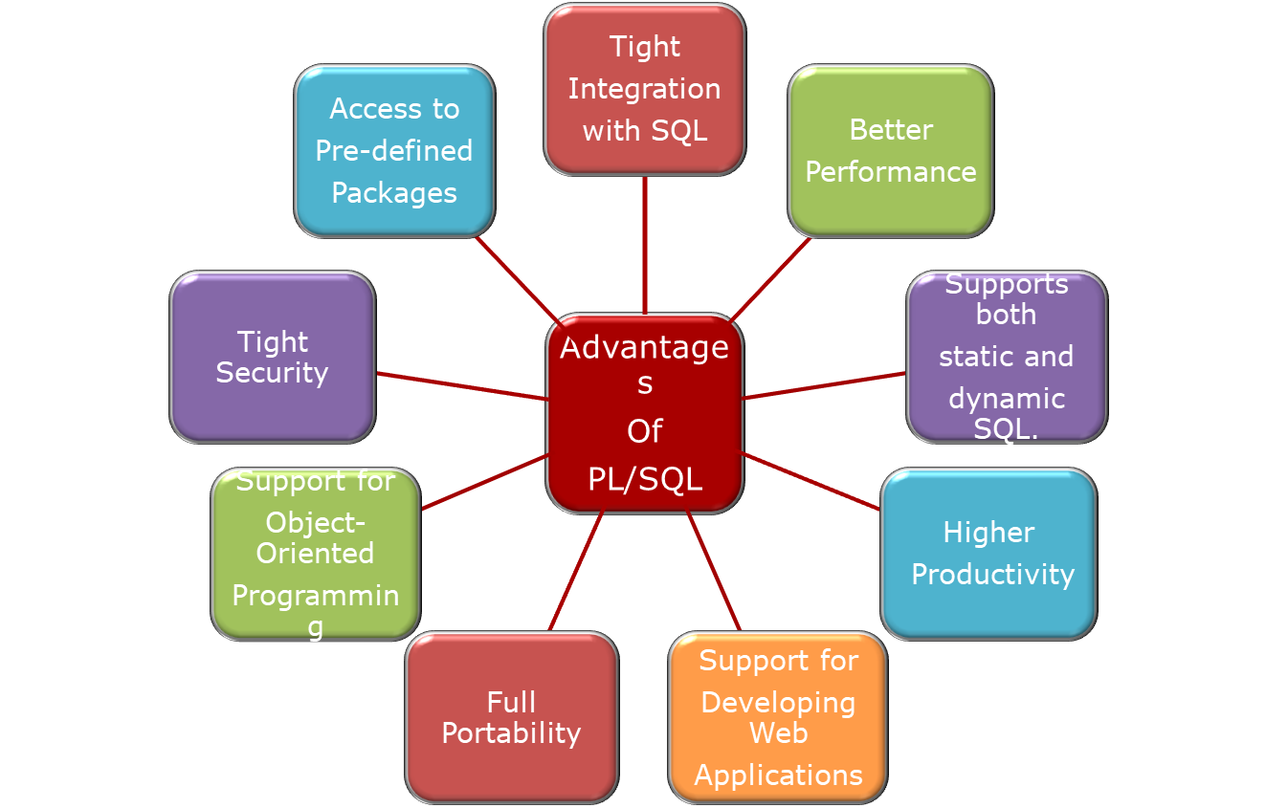
Advantages of PL/SQL
Notes:
Advantages of plsql
PL/SQL has the many advantages:
Tight Integration with SQL
PLSQL has a very tight Integration with SQL.
PL/SQL lets you use all the SQL data manipulation, and transaction control statements, as well as all the SQL functions, operators, and pseudo columns.
This extensive SQL support lets you manipulate Oracle data flexibly and safely.
Also, PL/SQL fully supports SQL data types, reducing the need to convert data passed between your applications and the database. As well as in addition to SQL data types, PL/SQL offers numerous data types.
We can call plsql functions within sql statements.
For Example:
SELECT account_no, account_name, has_taken_tariffplan(account_no) FROM account;
Here has_taken_tariffplan() is plsql function.
Better Performance
Executing in close proximity to the data in the database, PL/SQL allows for highly efficient database reads and writes. Let us see few scenarios
Scenario 1
Without PL/SQL, Oracle must process SQL statements one at a time. Each SQL statement results in another call to Oracle and higher performance overhead. Every time a SQL statement is issued, it must be sent over the network, creating more traffic.
With PL/SQL, an entire block of statements can be sent to Oracle at one time. This can drastically reduce communication between your application and Oracle.
You can use PL/SQL blocks and subprograms to group SQL statements before sending them to the database for execution. PL/SQL also has language features to further speed up SQL statements that are issued inside a loop.
Scenario 2
PL/SQL's variables store data in the same internal binary format as the database. For example, when retrieving a numeric value from the database, you don't have to convert it from one set of bits in the database to a different set of bits in the program; you just make an exact copy of the bits. By contrast, if you read numeric data from the database into a Java program, you are likely to need to convert it into something like a Java "BigDecimal.
Scenario 3
server-side PL/SQL gets executed inside the same running program (in the same memory space) as the Oracle server itself. This translates into another performance win because there is extremely little communications overhead required for the program to talk with the database.
In fact, once a given block of code is loaded into memory, any number of users can use the same copy of it simultaneously which is useful for the Web/many applications.
Server-side code runs faster, is easier to maintain and test, and is less susceptible to change than code placed in the middle tier. Therefore, creating significant portions of an application in the database is a better approach.
Higher Productivity
PL/SQL saves time on design and debugging by offering a full range of software-engineering features, such as exception handling, encapsulation, data hiding, and object-oriented data types.
Full Portability
PL/SQL is the same in all environments.
Applications written in PL/SQL can run on any operating system and platform where the Oracle database runs. With PL/SQL, you can write portable program libraries and reuse them in different environments.
Tight Security
PL/SQL stored procedures move application code from the client to the server, where you can protect it from tampering, hide the internal details, and restrict who has access.
For example, you can grant users access to a procedure that updates a table, but not grant them access to the table itself or to the text of the UPDATE statement.
Triggers written in PL/SQL can control or record changes to data, making sure that all changes obey your business rules.
Access to Pre-defined Packages
Oracle provides product-specific packages that define APIs you can call from PL/SQL to perform many useful tasks.
For Example, DBMS_SCHEDULER is used to schedule any particular task. UTL_FILE allows to perform file handling operations. Etc.
Support for Object-Oriented Programming
PLSQL supports for object-oriented programming. It provides features like Abstraction, encapsulation, overloading, etc.
Support for Developing Web Applications and Pages
You can use PL/SQL to develop Web applications and Server Pages (PSPs).
Supports both static and dynamic SQL.
Static SQL is SQL whose full text is known at compilation time. Dynamic SQL is SQL whose full text is not known until run time. Dynamic SQL lets you make your applications more flexible and versatile.

Slide 10
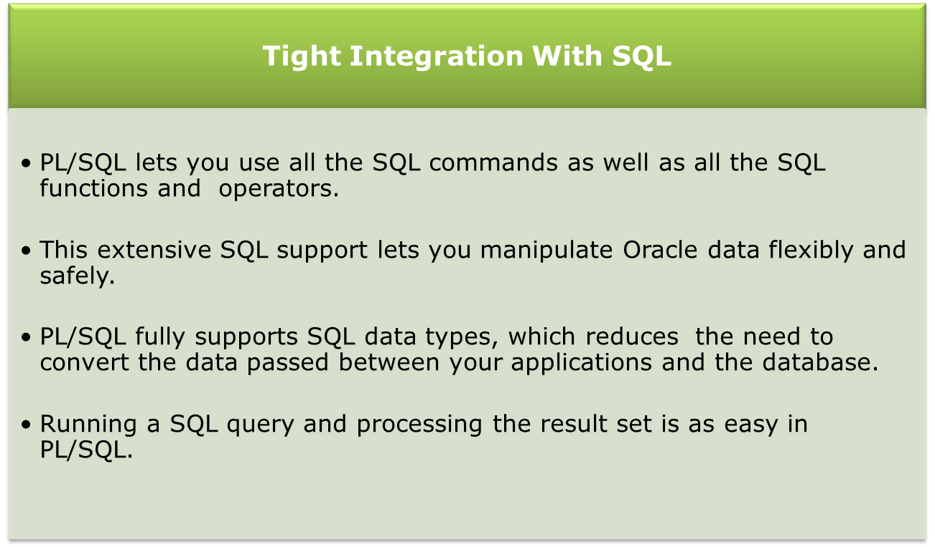
Advantages of PL/SQL

Slide 11
Advantages of PL/SQL
Better Performance
Application
Database
Sends multiple SQL Statements
SQL
Processes each SQL Statement and returns results appropriately
Sends a single PL/SQL block containing multiple SQL Statements
PL/SQL Block
Processes entire block returns a results
Sends a single
procedure call
Executes procedure containing multiple SQL statements and returns a results
Procedure Call

Slide 12
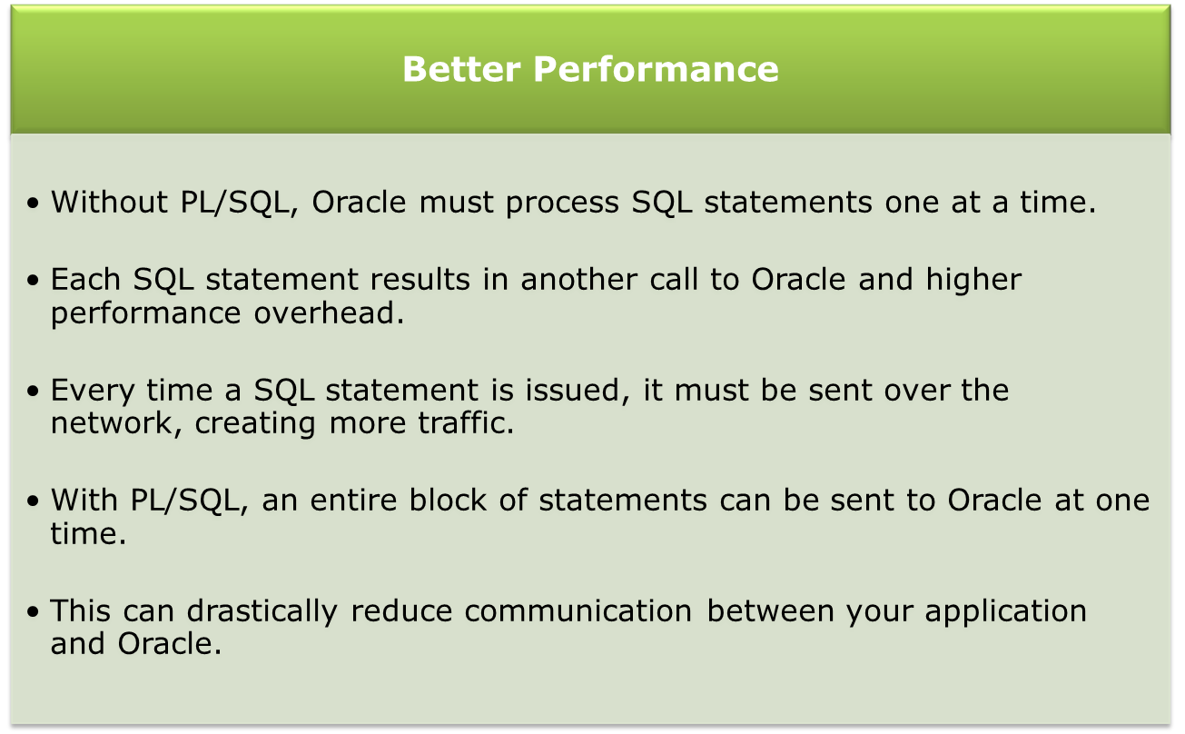
Advantages of PL/SQL

Slide 13
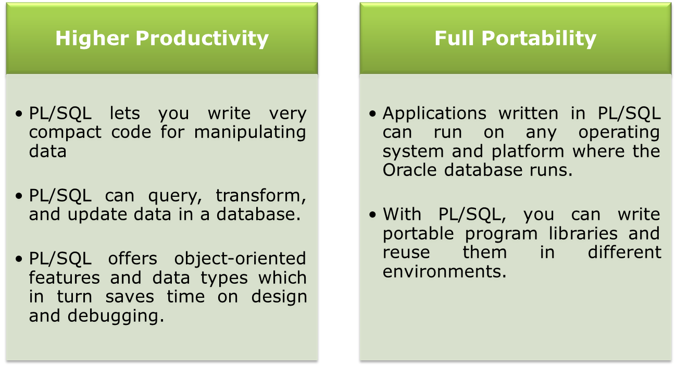
Advantages of PL/SQL

Slide 14
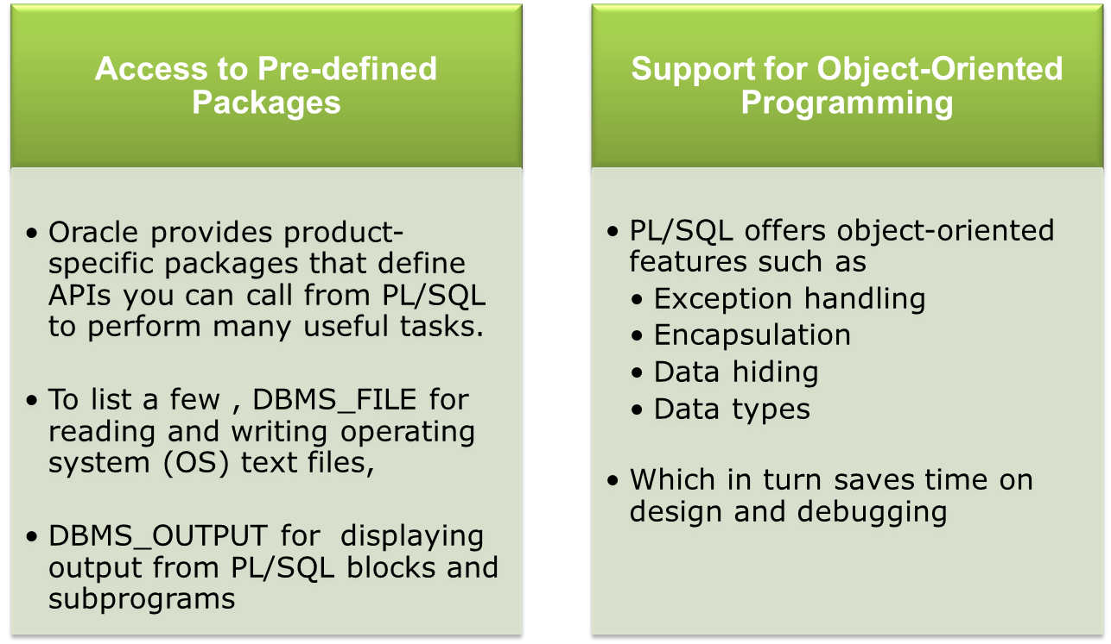
Advantages of PL/SQL

Slide 15
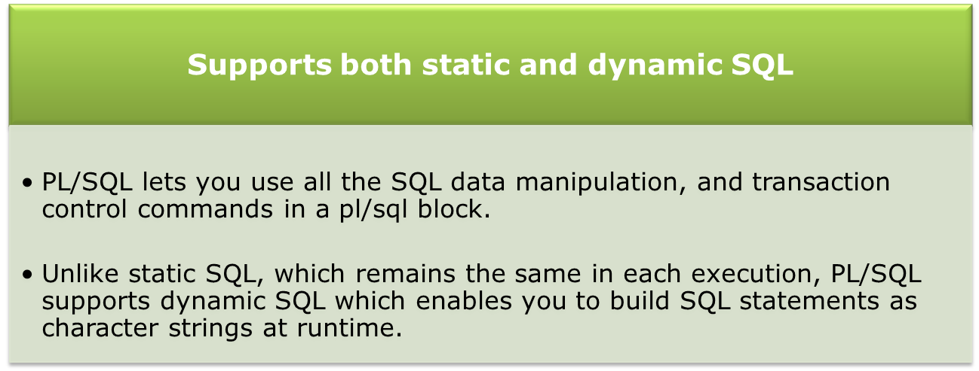
Advantages of PL/SQL

Slide 16
PL/SQL Architecture

Slide 17
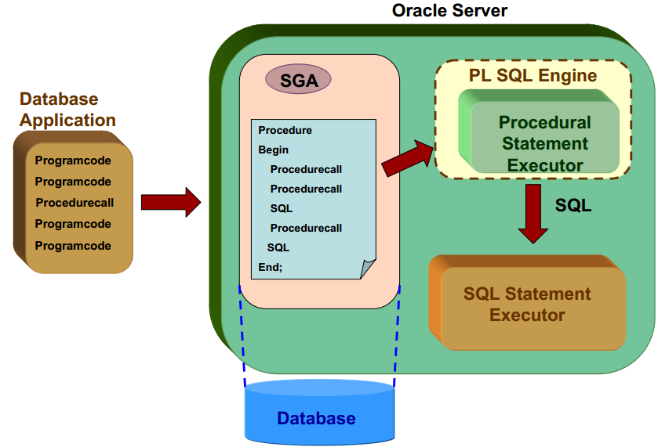
PL/SQL Architecture

Slide 18
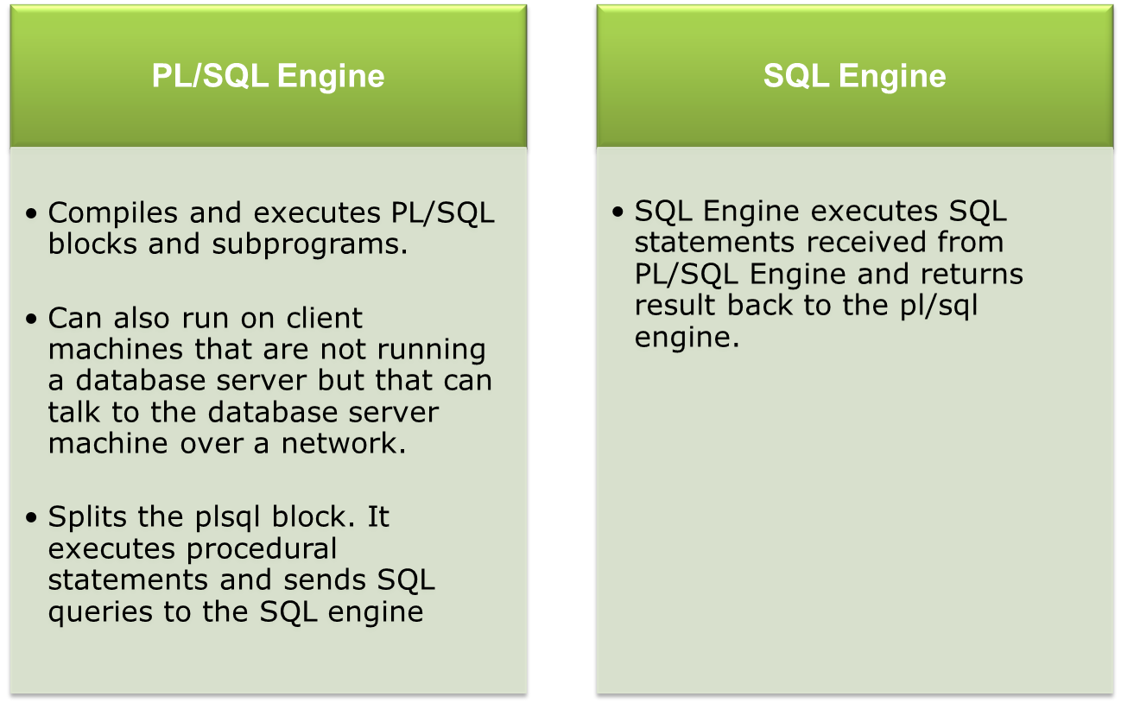
PL/SQL Architecture
Notes:
As we know PLSQL is an extension to SQL, You’ll find two engines in plsql architecture.
PLSQL Engine
Sql Engine
PLSQL Engine is a separator, which splits the SQL and PL/SQL statements. PL/SQL block comprises of SQL & PL commands are submitted as one request.

Slide 19
PL/SQL Environment

Slide 20
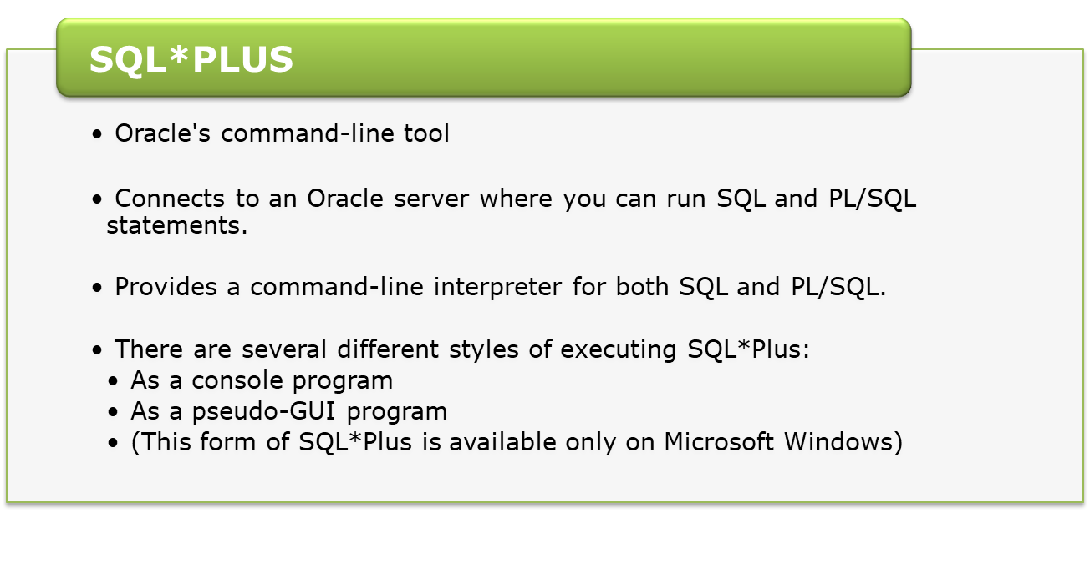
PLSQL Environment
PL SQL does not have its own environment.
There are various tools available to write code such as TOAD, SQL Developer, SQL*Plus i.e to see the result outside of PL/SQL requires another program

Slide 21
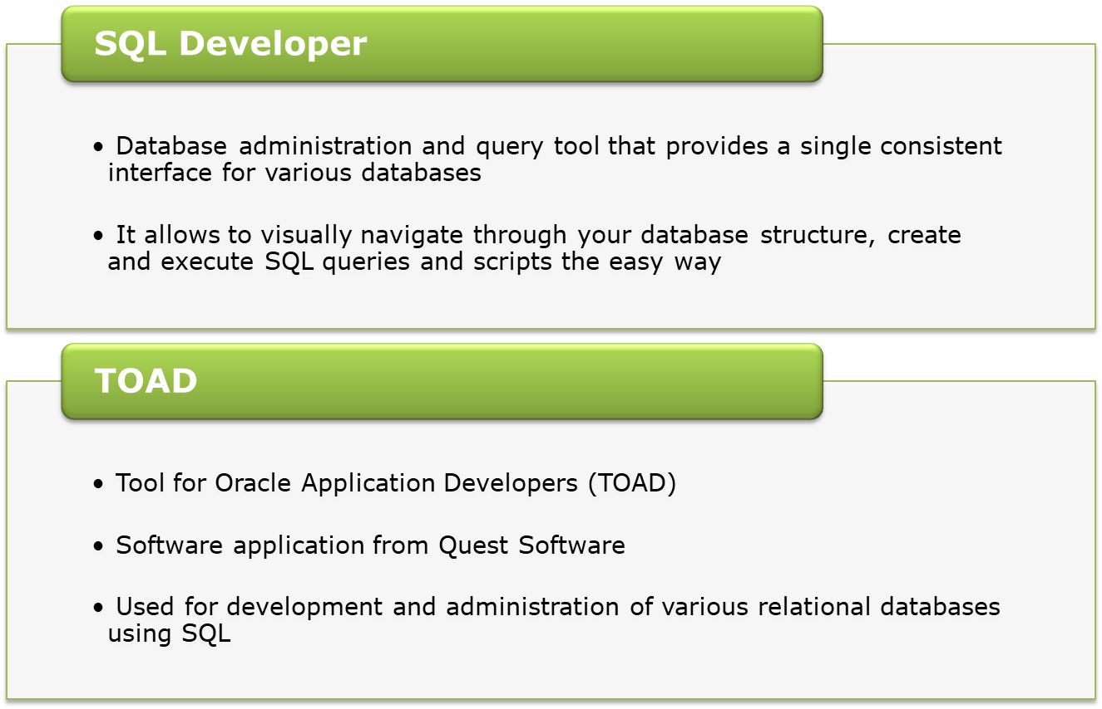
PLSQL Environment

Slide 22
PL/SQL Block

Slide 23
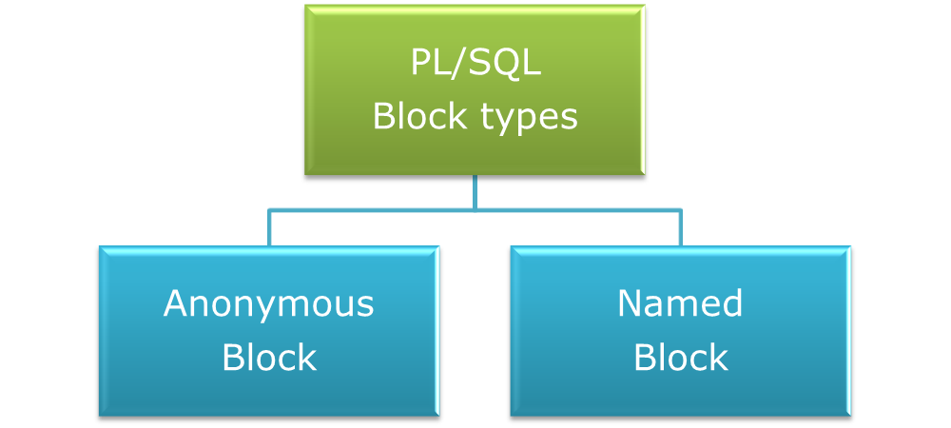
PL/SQL Block
PL/SQL is a block-structured language.
Each program written in PL/SQL is written as a block.
Blocks can also be nested.
Each block is meant for a particular task.
Notes:
To do anything really interesting with PL/SQL, you need an understanding of the fundamentals of the language
PL/SQL groups statements into units called blocks. These can either be named, in which case they are called subprograms, or unnamed, in which case they are anonymous blocks.
Anonymous Blocks are not stored in the database, they are declared inline, in the place where you want to run them.
Named blocks stored in the database. Subprograms and Triggers are e.g of Named Blocks
the PLSQL program can be divided into logical blocks.

Slide 24
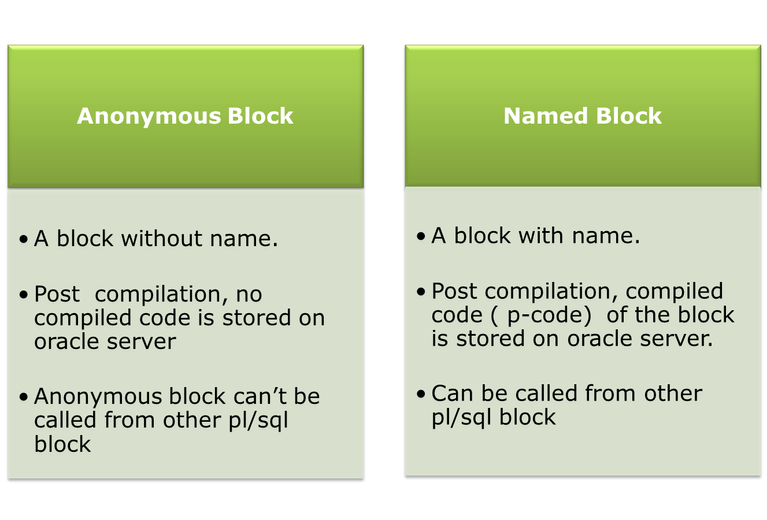
PL/SQL Block
Notes:
Named Block
Named block do have names.
Once compiled, Named blocks are getting stored on oracle server.
We can call them in ay other pl/sql block

Slide 25
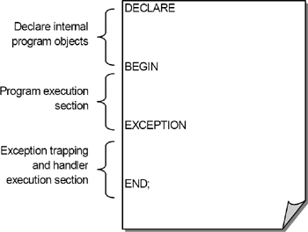
PL/SQL Anonymous Block
Notes:
To do anything really interesting with PL/SQL, you need an understanding of the fundamentals of the language
Blocks are the organizational unit for all PL/SQL code, whether it is in the form of an anonymous block, procedure, function, trigger or type.
PL/SQL groups statements into units called blocks. These can either be named, in which case they are called subprograms, or unnamed, in which case they are anonymous blocks.
Anonymous Blocks are not stored in the database, they are declared inline, in the place where you want to run them.
Named blocks stored in the database. Subprograms and Triggers are e.g of Named Blocks
the PLSQL program can be divided into logical blocks.

Slide 26
PL/SQL Named Block Structure
A PL/SQL named block has the following structure
IS
BEGIN
EXCEPTION
END;
Header (named blocks only)
Declare Section
Execution Section
Exception Section
Notes:
PL/SQL is a block-structured language.
A PL/SQL block is broken up into four different sections, as follows:
Header, Declaration section, Execution section, Exception section
Header: It is only applicable in case of named blocks. It defines type, name, parameters of a PL/SQL named block.
Declaration section includes statements that declare variables, constants, and other code elements, which can then be used within that block.
Execution section includes statements that are run when the block is executed
Exception section is a specially structured section you can use to “catch,” or trap, any exceptions that are raised when the executable section runs
Let us understand the significance of each of section of the block

Slide 27
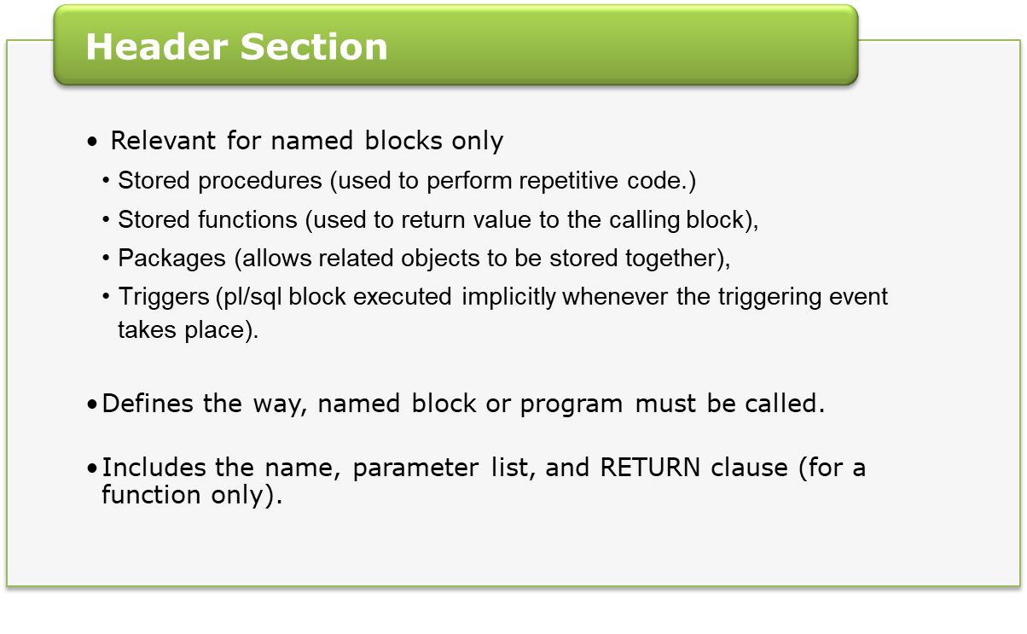
PL/SQL Block Structure

Slide 28
PL/SQL Block Structure
  Header Section: Example
    Below is header section of stored procedure:
  CREATE OR REPLACE PROCEDURE
  print ( p_num NUMBER ) …
    Below is header section of stored function:
  CREATE OR REPLACE FUNCTION
  add ( p_num1 NUMBER, p_num2 NUMBER )
  RETURN NUMBER …

Slide 29
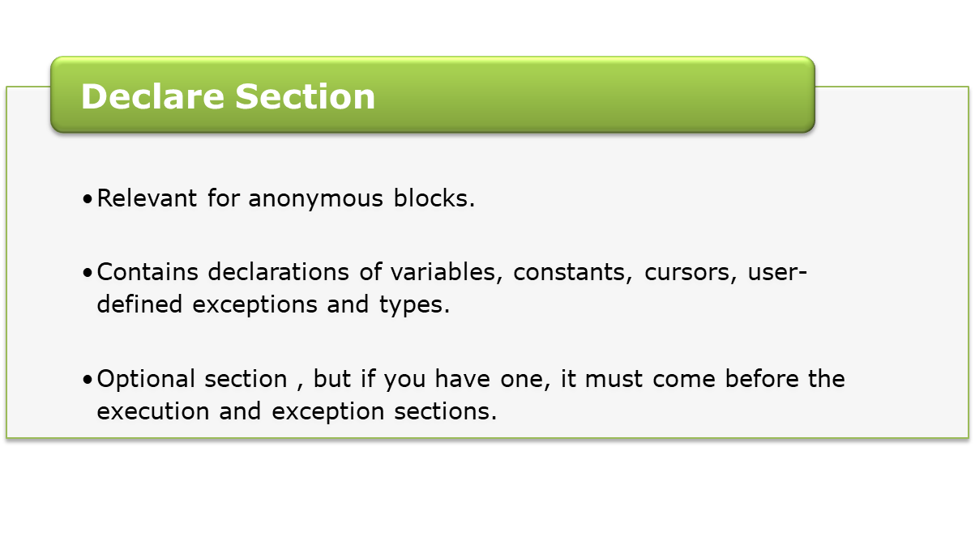
PL/SQL Block Structure
  DECLARE
  v_name VARCHAR2(35);
  v_id NUMBER := 0;
Notes:
A DECLARE section.
This section starts with the keyword DECLARE. It is an optional section and defines all variables, cursors, subprograms, and other elements to be used in the program.

Slide 30
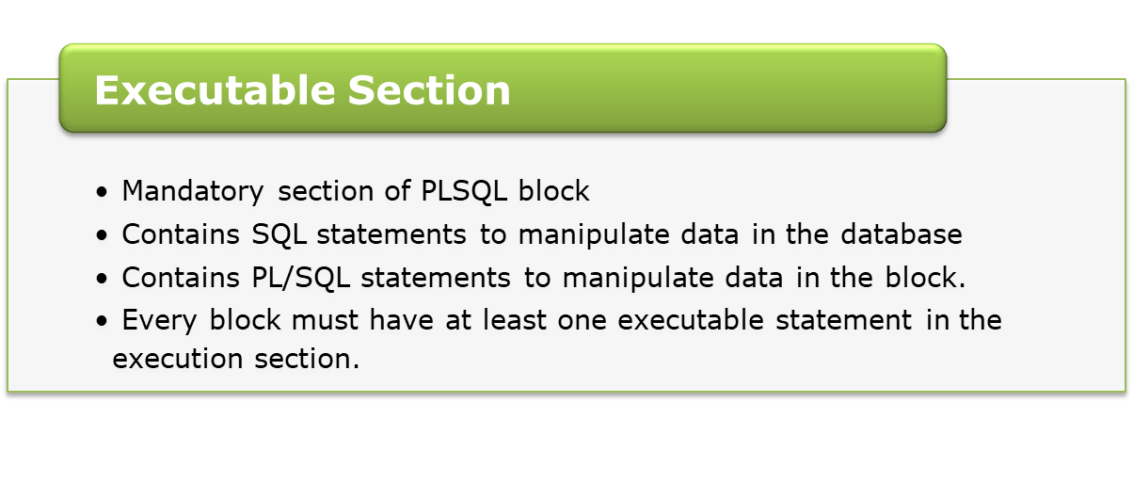
PL/SQL Block Structure
BEGIN
SELECT cust_name
INTO v_name
FROM customer
WHERE cust_id = 501 ;
DBMS_OUTPUT.PUT_LINE
(‘Customer name :’ || v_name);
END;

Slide 31
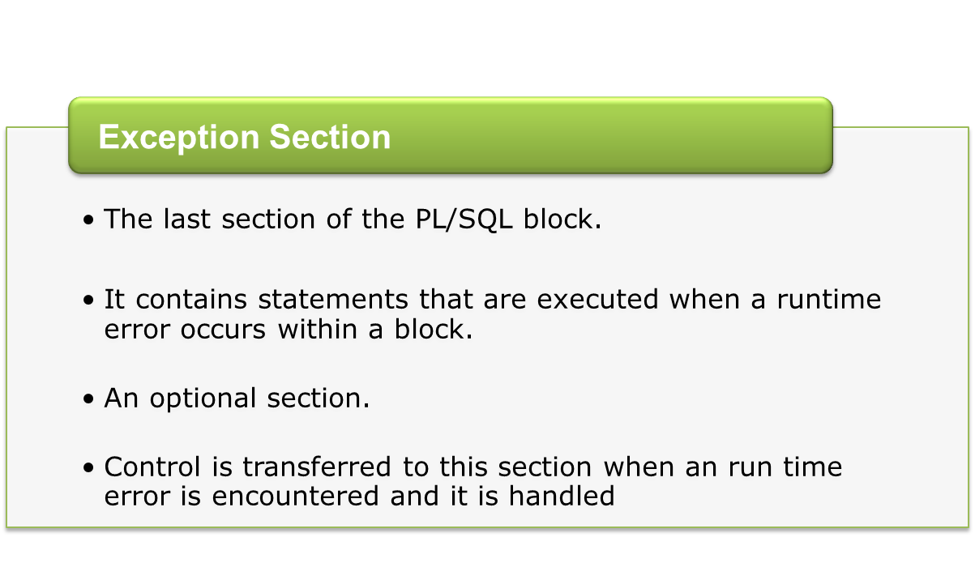
PL/SQL Block Structure
EXCEPTION
WHEN NO_DATA_FOUND THEN
  DBMS_OUTPUT.PUT_LINE
  (‘ There is no customer with Account no 501 ’);
END;

Slide 32
PL/SQL Datatypes

Slide 33
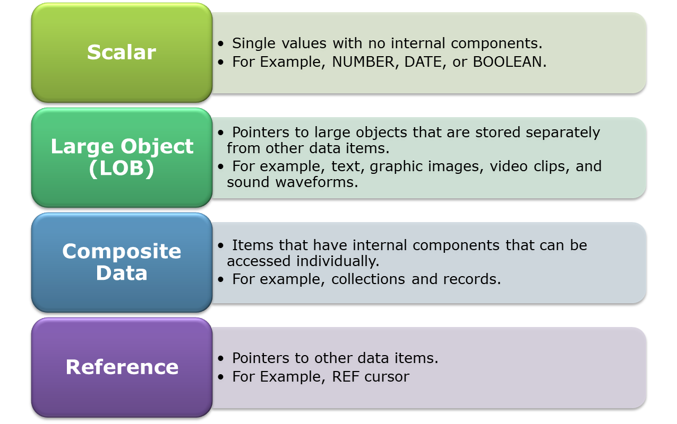
PL/SQL Data Types
The PL/SQL data types are divided into four categories
Notes:
Every constant, variable and parameter has a data type that determines its storage format,constraints, valid range of values and operations that can be performed on it. PL/SQL provides many predefined data types
PLSQL datatypes can be categorized as
Scalar types-- Variables of the sacalar types can hold a single value at a time.
Number, varchar2,date are few of the datatypes under this category
Composite types-
Used to hold one or more items of the same or dissimilar types; e.g. PL/SQL Records Variables of this can hold multiple values each of which can be of different type
Reference types Similar to Pointers in C; REF Cursor is an example of this datatype
Large Objects Large Objects (LOB): A large object can be either a binary or character value up to 4GB; e.g. BLOB, CLOB, NCLOB and BFILE
Kindly make a note here, The Boolean data type stores logical values TRUE ,FALSE and NULL.

Slide 34
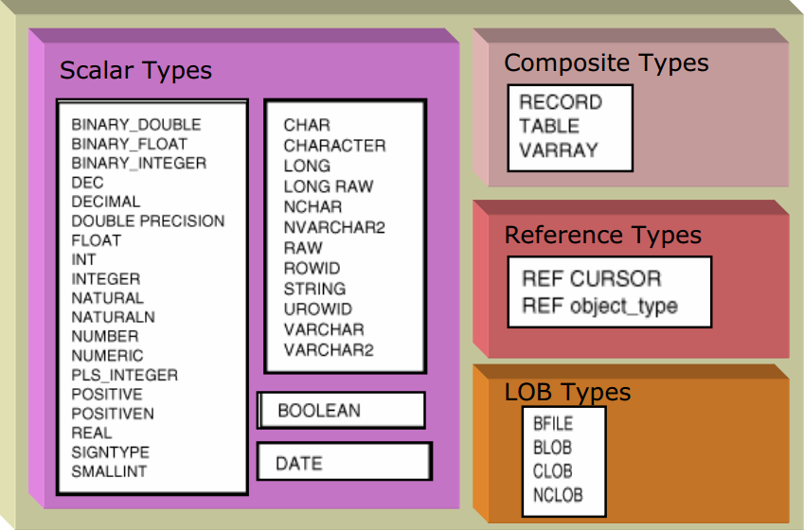
PL/SQL Data Types

Slide 35
PL/SQL Variables & Datatypes

Slide 36
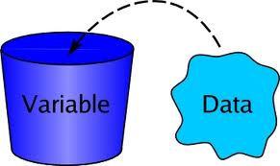
PL/SQL Variables
Placeholders to store the values that can be changed through the PL/SQL Block
PL/SQL lets you declare constants and variables, that be used in SQL and procedural statements
A constant or variable must be declared before referencing it in other statements
Notes:
Variables are placeholders that store the values that can change through the PL/SQL Block. Its value is varying hence it is known as variable.
PL/SQL lets you declare constants and variables, then use them in SQL and procedural statements anywhere an expression can be used
Constants are the placeholders which once initialized, their value cannot be altered.
We must declare a constant or variable before referencing it in other statements
You can declare variables and constants in the declarative part of any PL/SQL block, Declarations allocate storage space for a value, specify its Datatype, and name the storage location so that you can reference it.
Kindly make a note here, The names of constants, variables are not case sensitive.

Slide 37
PL/SQL Variables
Syntax for declaring variables
    variable_name [CONSTANT] datatype
    [NOT NULL] [:= expr | DEFAULT expr]
Note: Square brace indicates optional
    variable_name is the name of the variable.
    Datatype is a valid PL/SQL datatype.
    NOT NULL is an optional specification on the variable.
    A value or DEFAULT value is also an optional specification, used to initialize a variable.
    Each variable declaration is a separate statement and must be terminated by a semicolon.
    CONSTANT keyword is used to declare constants.
Notes:
A variable or a constant can be defined using the syntax specified
It is not mandatory to initialize a variable at the time of declaration but it is mandatory to initialize a constant. But when variable is specified as NOT NULL or CONSTANT in declaration, it becomes mandatory to initialize the variable with some value; this value can be altered
You can assign a default value to a variable when you declare it or after you have declared it with an assignment statement
Variables are initialized every time after a block is entered . By default variables are initialized to null
Unless you explicitly initialize a variable its value is NULL
To avoid unexpected result, never reference a variable before initializing it.

Slide 38
PL/SQL Variables
Valid variable declarations
  DECLARE
        v_Activedate DATE;
        v_Cust_id NUMBER(2) NOT NULL := 10;
        v_Address VARCHAR2(13) := ’Pune’;
        v_Sr_id NUMBER DEFAULT 201;
        Or
        v_Sr_id NUMBER :=201;
        v_Name VARCHAR2(20) DEFAULT ‘Aditya’
    Valid constant declaration
c_constant CONSTANT NUMBER := 1400;
Invalid Declarations
v_cust_id NUMBER(2) NOT NULL;
v_name VARCHAR2 DEFAULT ‘Sachin’;
c_constant CONSTANT NUMBER ;
c_constant NUMBER CONSTANT;
Notes:
Here are few valid declarations of variables and constants
Take few minutes to understand the syntax
In the declaration of a constant, the keyword CONSTANT must precede the type specifier

Slide 39
Guidelines for Declaring PL/SQL Variables
Follow the naming rules
    The variable name must be less than 31 characters
    The starting of a variable must be an ASCII letter
    It can be either lowercase or uppercase
    A variable name can contain numbers, underscore, and dollar sign characters followed by the first character
Follow the naming conventions
    Initialize variables designated as NOT NULL and CONSTANT
    Declare one identifier per line
    Initialize identifiers by using the assignment operator (:=) or the reserved word “DEFAULT”

Slide 40
Assigning values to variable
There are various ways to assign values to a variable
  Using assignment operator(:=)
  Database values can be assigned to a variable using a SELECT statement
v_cust_id := 501 ;
SELECT cust_name
INTO v_name FROM customer
WHERE cust_id = v_cust_id ;;
Notes:
You can assign values to variables in different ways. One way is initialize the variable using assignment operator as shown on the slide
You may want to read a value from the database and assign it to a variable. This is done using the SELECT statement

Slide 41

Inheriting data type
While assigning value from table column, you may face few problems
To avoid this you can declare variables to inherit the data-type of a database column or other variable
What if, table column data length is greater than variable length?
What if, somebody alters the table column?
v_cust_id Customer.cust_id%TYPE ;
Datatype of v_cust_id is same as the datatype of the cust_id column of the customer table
Notes:
Let us take an example,
Suppose I have declared a variable v_accno of NUMBER(2) data type, and I want to fetch data from customer table. What if, I have account_nos exceeding length 2. In such scenarios, we need to keep data type same as column data type.
Now also consider the scenario, I have declared variable v_accno of the same data type as account_no column from customer table. Suppose if somebody alters datatype of account_no column. How to deal with such situations?
When we assign a value read from a table column to a variable , we have to ensure that the data type of the column and that of the variable is same, else this may lead to run time errors.
To avoid this you can declare variables to inherit the data-type of a database column or other variable
To have the variable inherit the Datatype of a database column or of another variable, use the %TYPE attribute in place of a declared Datatype.

Slide 42
Inheriting data type
%TYPE is used to declare variables in PL/SQL with same type as that of a specified tables’s column
If the datatype or precision of a column changes, the program automatically picks up the new definition from the database.
Provides data independence, reduce maintenance costs, and allows programs to adapt as the database changes

Slide 43
Inheriting data type
To read an entire row and assign it to a variable, the variable should be declared as Rowtype
v_CustRow Customer%ROWTYPE ;
Declare
….
….
<record variable> <table_name>%ROWTYPE;
eg: area_rec service_area%ROWTYPE;
service_area Table
Service_area table structure will be automatically copied to record variable
e.g. area_rec
Database
Notes:
%ROWTYPE qualifier signifies that the variable Datatype should be a record structure that matches the specified table structure. The advantages of declaring the record as a ROWTYPE are:
1) You do not need to explicitly declare variables for all the columns in a table.
2) If you alter the column specification in the database table, you do not need to update the code.

Slide 44
Inheriting data type
For a ROWTYPE variable, fields will be created for all the columns in the table and memory will be assigned as per the data type of all the fields.
ROWTYPE should be used when all the columns of the table are required in the program.
In case of %TYPE and %ROWTYPE, the attributes
do not inherit the constraints on the columns
of the database table.

Slide 45

Record Type
%TYPE and %ROWTYPE work with single value and one complete record respectively.
Consider a Scenario: We need to work with only seven columns of a table containing 20 columns.
  If we use %ROWTYPE, we get all 20 values unnecessarily.
  If we use seven %TYPE declarations, it will be bit clumsy
How do we create our own composite data type, with our own specified number of values to hold?
Record Type offers you to define our own data type

Slide 46
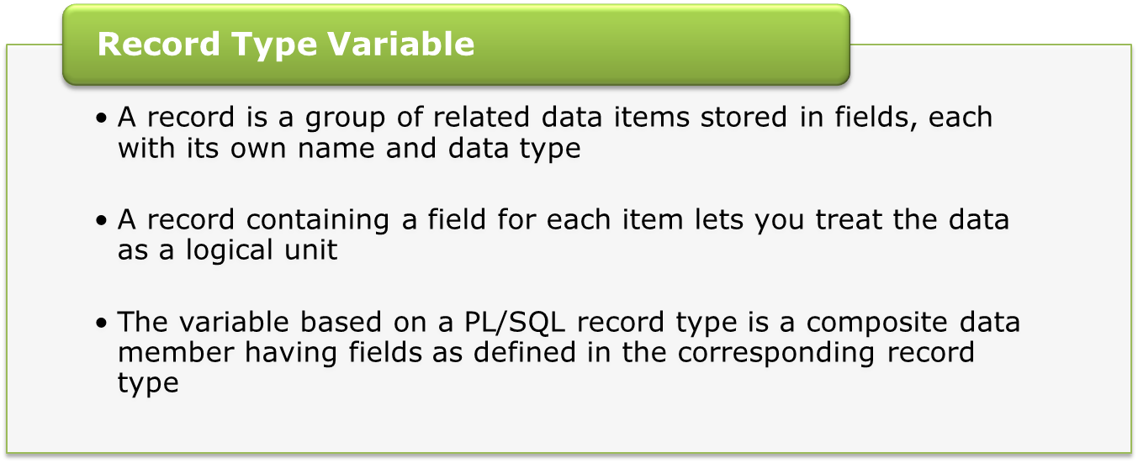
Record Type Variable
TYPE type_name IS RECORD (field_declaration[,field_declaration]...);
variable_name type_name;

Slide 47
PL/SQL Variables
Declaring variable of record type
DECLARE
-- Type declaration
    TYPE ServiceReq IS RECORD(
    id service_request.sr_id%TYPE,
    status service_request.status%TYPE,
    comments service_request.comments%TYPE
    );
    -- Record type variable declaration
    VService_Rec ServiceReq;
VService_Rec
id | number(10)
status | varchar2(25)
comments | varchar2(75)

Slide 48
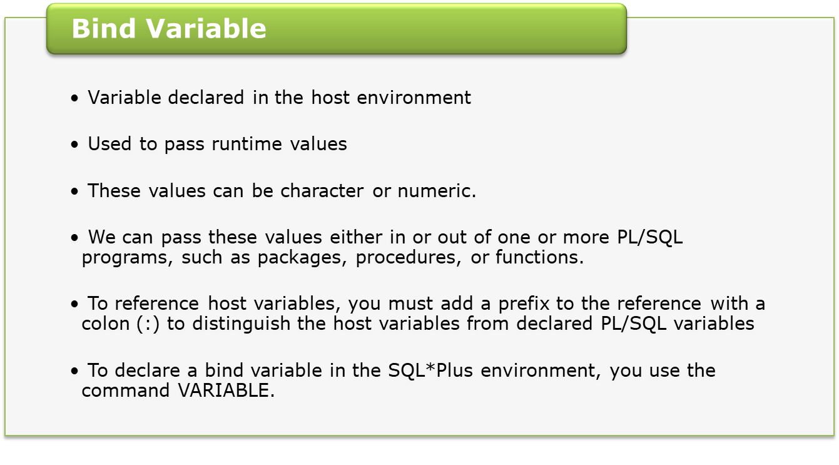
PL/SQL Variables
VARIABLE variablename datatype;

Slide 49
Subtypes
Subtype is based on existing data type and allows you to create your own application specific data types
As an example, consider variables like Salary, Payment, Cost etc which are of currency type, so you may declare a subtype currency as follows
SUBTYPE Currency IS NUMBER(10,2);
With this you can now declare variables as follows:
v_Payment Currency;
v_cost Currency;
Advantage of using subtypes is increased readability, maintainability

Slide 50
Operators in PL/SQL
Arithmetic Operators
*, /, +, -
Comparison Operators
>, < , >= , <= , <> , = , IN , BETWEEN, LIKE, IS
Logical Operators
NOT, AND, OR
Other Operators
.. , **, ||
Notes:
PL/SQL provides various operators for mathematical expression evaluation, for evaluating relational expression, logical operator as well as other operators like range operator, exponentiation operator represented by ** and concatenation operator represented by double vertical bars (||), which appends one string to another

Slide 51
Comments in PL/SQL
To comment line or lines in a PL/SQL program use,
  -- for single line comment
  /* */ for multi-line comment
Notes:
Adding comments to your program promotes readability and aids understanding. Generally, you use comments to describe the purpose and use of each code segment. PLSQL compiler ignores comments
PL/SQL supports two comment styles: single-line and multi-line.
Single-Line Comments
Single-line comments begin with a double hyphen (--) anywhere on a line and extend to the end of the line.
Multi-line Comments
Multi-line comments begin with a slash-asterisk (/*), end with an asterisk-slash (*/), and can span multiple lines.

Slide 52
Using SQL Functions in PL/SQL
Available in procedural statements
    Single-row number and character functions
    Data type conversion functions
    Date functions
Not available in procedural statements
    Decode Function
    Group Functions (Directly)
Valid use of functions in a PL/SQL block:
v_name := UPPER(‘ketan’);
v_date := TO_DATE(’12,February 1998’,’DD,Month YYYY’);
Invalid use of functions in a PL/SQL block:
v_cnt_sr := COUNT(sr_id);
v_grade := DECODE(owner_designation,’MANAGER’,’A’,’CSR,’B’,’C’);
Notes:
We can use almost all SQL functions in pl/sql except decode function.
We can use single row functions directly in pl/sql expressions, but while using group functions can not use them directly in pl/sql statements.
Here are some examples of Valid and invalid use of SQL functions.

Slide 53
Executing PL/SQL Blocks

Slide 54
First PL/SQL Block
DBMS_OUTPUT is a package which is used for debugging, or for displaying messages SQL*Plus
PUT_LINE is a procedure within that package; it accepts a line of information as input
  BEGIN
  DBMS_OUTPUT.PUT_LINE(‘Hello! Welcome to PL/SQL’);
  END;
Notes:
DBMS_OUTPUT.PUT_LINE displays a message, value of a variable or both on to the screen
Kindly take a note here, DBMS_OUTPUT.PUT_LINE procedure has only one parameter of data type VARCHAR2. So if you need to print values of any variable, first it needs to convert into VARCHAR2. Most of the time conversion part is done implicitly.
Kindly make a note here, by default SQL*Plus doesn’t show output. We need enable it by setting environment variable SERVEROUTPUT to ON mode. We need to issue SET SERVEROUTPUT ON command for the same. Its only one time activity that’s effect remains till session ends. Now execute the same program once again and see the output.

Slide 55
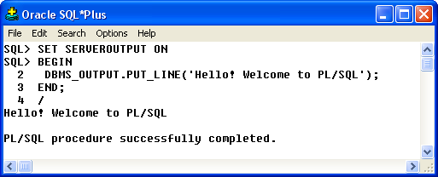
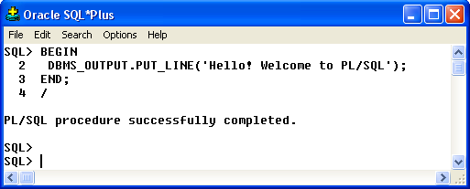

Executing PL/SQL Block
Now, let us execute our first pl/sql block.
Expected output: Hello! Welcome to PL/SQL
Look at the screen shot below.
By default, SQL*PLUS doesn't read what a PL/SQL program has written with DBMS_OUTPUT.
With set serveroutput on, this default behaviour is changed.
Where is the
output?
Hit any key to see the output.
SET SERVEROUTPUT ON is a SQL*Plus command .
Notes:
DBMS_OUTPUT.PUT_LINE displays a message, value of a variable or both on to the screen
Kindly take a note here, DBMS_OUTPUT.PUT_LINE procedure has only one parameter of data type VARCHAR2. So if you need to print values of any variable, first it needs to convert into VARCHAR2. Most of the time conversion part is done implicitly.
Kindly make a note here, by default SQL*Plus doesn’t show output. We need enable it by setting environment variable SERVEROUTPUT to ON mode. We need to issue SET SERVEROUTPUT ON command for the same. Its only one time activity that’s effect remains till session ends. Now execute the same program once again and see the output.

Slide 56
Executing PL/SQL Block
When we write PL/SQL statements on the console or pseudo-GUI SQL*Plus, the program assigns a number to each line.
Line numbers helps in identifying the line number to edit
If Oracle detects an error in your code, it will usually report the error accompanied by a line number
Alternately, we can write a PLSQL script ( A plsql code saved in a file)
    Save the previous code in the text file with name "First.sql"
    To execute the script , type the following command at SQL*Plus prompt
      SQL > @ "First.sql"

Slide 57
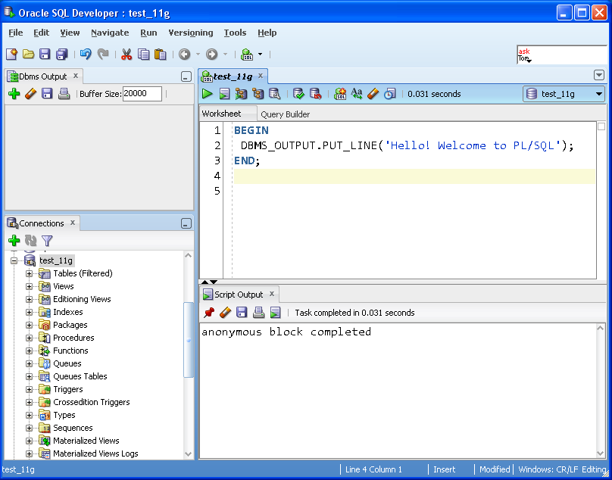
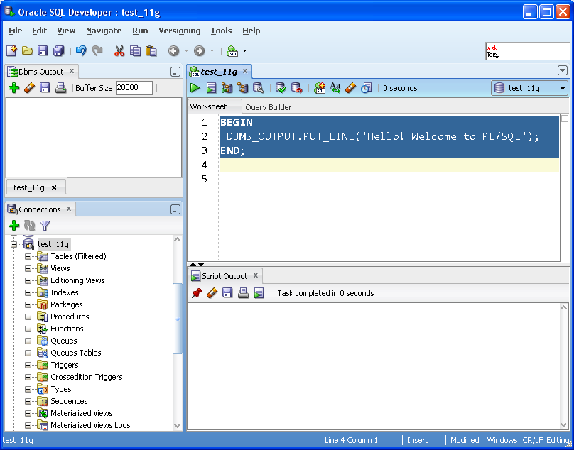
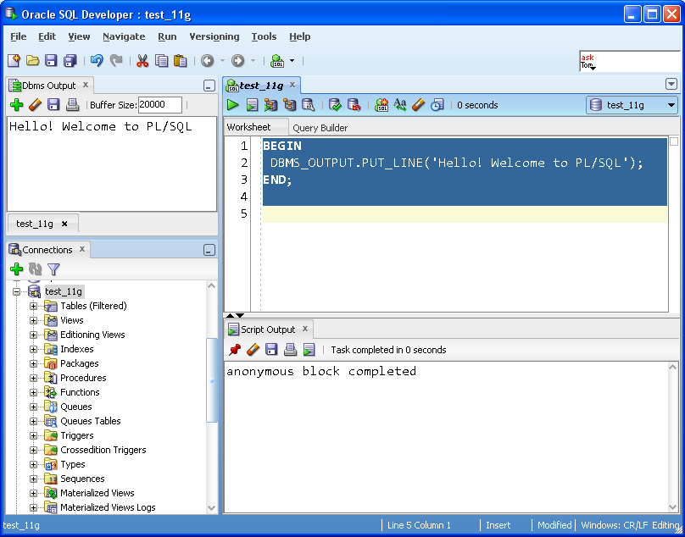





First PL/SQL Block
Executing PLSQL Block in SQL Developer
To run the program,
you need to select program
and click on this button
This is the place where you
can see output of pl/sql
program
To see the output, you
need to click on this button
Once you click on this button,
You’ll be prompted to
Choose connection.

Slide 58
PL/SQL Named Block
  CREATE OR REPLACE PROCEDURE print
  IS
  BEGIN
  DBMS_OUTPUT.PUT_LINE(‘Hello! Welcome to PL/SQL’);
  END;
Executing PL/SQL Named block from any PL/SQL block
Executing PL/SQL Named block from host environment using EXECUTE statement.
  BEGIN
  print;
  END;
  SQL> EXECUTE print;
EXECUTE is not a PL/SQL command, cannot be used inside PL/SQL block.
Notes:
DBMS_OUTPUT.PUT_LINE displays a message, value of a variable or both on to the screen
Kindly take a note here, DBMS_OUTPUT.PUT_LINE procedure has only one parameter of data type VARCHAR2. So if you need to print values of any variable, first it needs to convert into VARCHAR2. Most of the time conversion part is done implicitly.
Kindly make a note here, by default SQL*Plus doesn’t show output. We need enable it by setting environment variable SERVEROUTPUT to ON mode. We need to issue SET SERVEROUTPUT ON command for the same. Its only one time activity that’s effect remains till session ends. Now execute the same program once again and see the output.

Slide 59

PL/SQL Program: Using variables
DECLARE
X NUMBER(3) := 10;
Y NUMBER(3) := 20;
BEGIN
DBMS_OUTPUT.PUT_LINE
(‘The value of variable X is : ‘ || X);
DBMS_OUTPUT.PUT_LINE
(‘The value of variable Y is : ‘ || Y);
END;
DBMS_OUTPUT.PUT_LINE accepts single line.
Multiple values are concatenated using || and passed as single line
Notes:
This is a simple PL/SQL program. It has 2 variables x & y assigned values 10 & 20 respectively.
Executable block will simply print the output as
The value of variable X is : 10
The value of variable Y is : 20
For each execution, a PL/SQL block is first compiled by the PLSQL compiler and if there are any compilation errors then the errors are shown. If compilation is successful then the block is immediately executed. A PL/SQL block is not stored in the database so to execute it again it has to be reloaded.
If you are working on SQL*Plus, you need to add forward slash at last line of program.

Slide 60
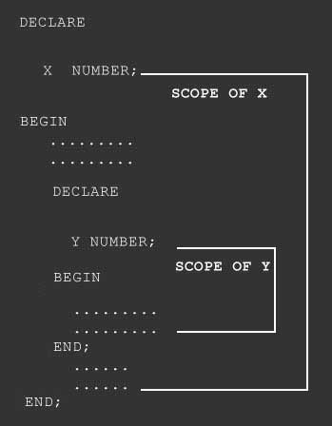
Nested Blocks
A block within a block called as a Nested Block
Notes:
The variable declared in any block is live as long as the block in which it is declared is getting executed.
In the Nested Block above, the variable X is declared in the outer block and hence it is available in the inner as well as the outer block however the variable Y is declared in the inner block hence it is available only to the inner block.
Now suppose the variable declared in the inner block is also given the same name as the variable in outer block say X then in the inner block when we refer to X it will be always taken as the local variable X and not X of outer block. This effect is called as “Local Screening”. In such situation if one wants to refer to the variable of the outer block then the outer block is given a label and in the inner block when one wants to refer to the outer block variable then it is prefixed with the outer block label.
Nested blocks are also useful in exception handling where you know the situation that exception may raised, but still you don’t want program to terminate.

Slide 61
Example: Labeled Nested Block
-- Outer Block Starts here
<<l_outer>> -- Label given to the outer block
DECLARE
v_custname VARCHAR2(20) := 'Neeta';
v_address VARCHAR2(20) := ‘Mumbai’;
BEGIN
DECLARE -- Inner Block Starts Here
v_custname VARCHAR2(30) :='Richa';
v_address VARCHAR2(20) := 'Pune';
BEGIN
DBMS_OUTPUT.PUT_LINE(l_outer.v_custname);
DBMS_OUTPUT.PUT_LINE (v_custname);
END; -- Inner block ends
DBMS_OUTPUT.PUT_LINE (v_custname);
DBMS_OUTPUT.PUT_LINE (v_address);
END; -- Outer Block Ends

Slide 62
Using SQL in PL/SQL

Slide 63
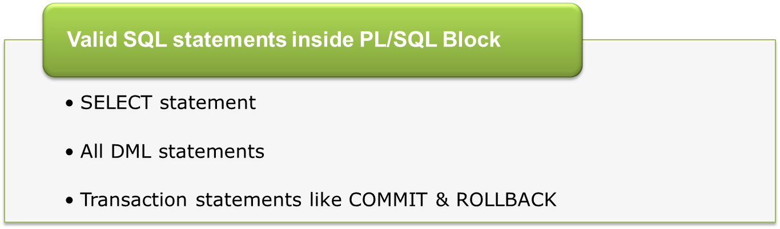
Using SQL in PL/SQL
Notes:
PL/SQL is a database programming language. Almost all the programs you will ever write in PL/SQL will read from or write to—or read from and write to—Oracle Database by using SQL.
Oracle Database makes it very easy to write and run SQL statements in PL/SQL. For the most part, you simply write the SQL statement directly in your PL/SQL block and then add the code needed to interface between the SQL statement and the PL/SQL code.
You can use SELECT statements, DML statements as well as TCL statements in PL/SQL block.
While using SELECT statements, keep in mind it returns the result. For which you need to store the query result into a local variable, which you can do with the INTO clause.
Select query used in a pl/sql block is expected to return only 1 row.

Slide 64
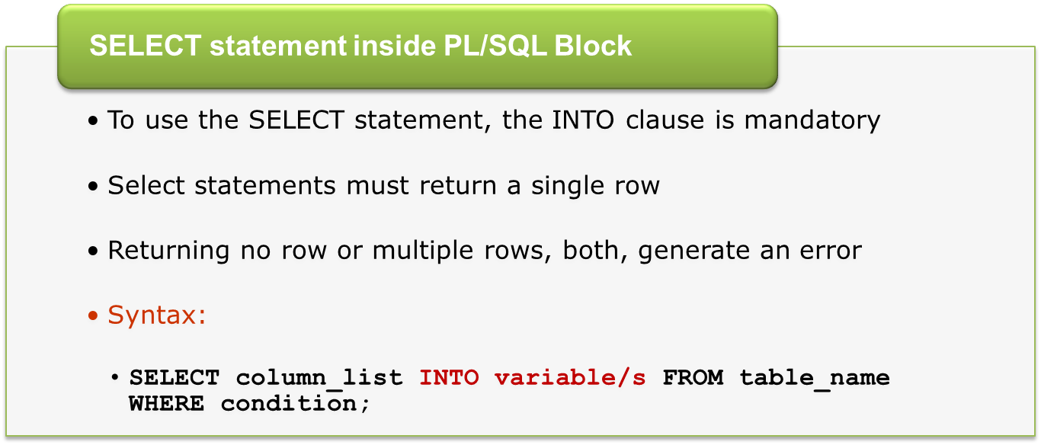
Using SQL in PL/SQL
Notes:
PL/SQL is a database programming language. Almost all the programs you will ever write in PL/SQL will read from or write to—or read from and write to—Oracle Database by using SQL.
Oracle Database makes it very easy to write and run SQL statements in PL/SQL. For the most part, you simply write the SQL statement directly in your PL/SQL block and then add the code needed to interface between the SQL statement and the PL/SQL code.
You can use SELECT statements, DML statements as well as TCL statements in PL/SQL block.
While using SELECT statements, keep in mind it returns the result. For which you need to store the query result into a local variable, which you can do with the INTO clause.
Select query used in a pl/sql block is expected to return only 1 row.

Slide 65
How SQL is getting executed?
Declare
V_date Date;
Begin
v_date := get_next_bill_date(‘Ashwini’);
Update customer set next_bill_dtm=v_date
where account_name=’Ashwini’;
Dbms_output.put_line
(‘Next_bill_dtm updated’);
End;
PLSQL Engine
SQL Engine
Declare
V_date Date;
Begin
v_date := get_next_bill_date(‘Ashwini’);
Update customer set next_bill_dtm=v_date
where account_name=’Ashwini’;
Dbms_output.put_line
(‘Next_bill_dtm updated’);
End;
Update customer set next_bill_dtm=v_date
where account_name=’Ashwini’;
Next_bill_dtm updated
Declare
V_date Date;
Begin
v_date := get_next_bill_date(‘Ashwini’);
Update customer
set next_bill_dtm=v_date
where account_name=’Ashwini’;
Dbms_output.put_line
(‘Next_bill_dtm updated’);
End;
Database
Notes:
In real life applications, user may access database from any Front End application as WEB Portal. Front end application simple invoke any function or procedure.
PLSQL engine splits PL & SQL part and send SQL part to SQL statement executor and PL part to plsql statement executor.
PLSQL gathers result back and sends result to front end.
In this example, PL/SQL engine accepts a PLSQL block as input.
This code contains update statement which is a SQL statement and rest all are plsql statements.
This code is passed as input to the PLSQL Engine, plsql engine will execute PL part and pass Update statement to SQL engine for execution. SQL engine updates the database and send acknowledge to the PLSQL engine. PLSQL engine further sends output to the invoking program.

Slide 66
Using SELECT… INTO.. with %TYPE
DECLARE
v_cust_id customer.cust_id%TYPE := &custid;
v_cust_name customer.cust_name%TYPE;
BEGIN
SELECT cust_name INTO v_cust_name
FROM customer WHERE cust_id=v_cust_id;
DBMS_OUTPUT.PUT_LINE
(' The name is : '||v_cust_name);
END;
Notes:
First we have declared a local variable and in doing so we are using another feature of PL/SQL i.e. the ability to anchor the datatype of my variable back to a table’s column. (Anchoring is covered in more detail later in this series.)
I then execute a query against the database, retrieving the last name for the employee and depositing it directly into the l_name variable.

Slide 67
Using SELECT… INTO.. with %ROWTYPE
  DECLARE
  v_ownerid service_owner.owner_id%TYPE
  ownerRec service_owner%ROWTYPE;
  BEGIN
  v_ownerid := &ownid;
  SELECT * INTO ownerRec
  FROM service_owner WHERE owner_id=v_ownerid;
  DBMS_OUTPUT.PUT_LINE(ownerRec.owner_id);
  DBMS_OUTPUT.PUT_LINE(ownerRec.owner_name);
  DBMS_OUTPUT.PUT_LINE
  (ownerRec.owner_designation);
  END;
Notes:
In the above program, instead of using %ROWTYPE we could have declared 3 separate variables as shown below
Eg. # 1
What if we want more and more columns of values to be retrieved and pushed into variables?
Consider a table of fifteen columns. Is it necessary to declare fifteen different variables to retrieve those values?
In such situation %ROWTYPE is very convenient. It can be used to declare a single ROWTYPE variable to store an entire row from the specified table.

Slide 68
Using SELECT… INTO.. with Record Type
Example
DECLARE
TYPE t_ServiceArearec IS RECORD
(
Service_area_code Service_area.Service_area_code%type,
area_desc Service_area.area_desc%TYPE);
r_ServiceArearec t_ServiceArearec;
BEGIN
SELECT service_area_code, area_desc
INTO r_ServiceArearec
FROM Service_area where service_area_code=101;
DBMS_OUTPUT.PUT_LINE
(r_ServiceArearec.Service_area_code || ', ' ||
r_ServiceArearec.area_desc );
END;
We can use record type variable to fetch data from a select query that uses join between more than two tables.

Slide 69
Using DML in PL/SQL
To manipulate data in the database use DML statements
INSERT, UPDATE and DELETE in PL/SQL
INSERT
BEGIN
INSERT INTO service_owner
VALUES(&p_ownerid,&p_ownername,&p_owndesgn);
END;
Notes:
Note that
For the program in the PPT, if the value you are trying to insert for the empno column is already present in the emp table, then the program will show an error message, if there is a primary key constraint on the empno column

Slide 70
Using DML in PL/SQL
UPDATE
BEGIN
UPDATE service_owner
SET owner_designation = &p_owndesgn
WHERE owner_id = &p_owner_id;
END;

Slide 71
Using DML in PL/SQL
DELETE
BEGIN
DELETE FROM service_owner
WHERE owner_id = &p_owner_id;
END;

Slide 72

Using Sequence in PLSQL
  BEGIN
  -- Using a sequence to autogenerate the primary key column values
  INSERT INTO customer (cust_id, cust_name) VALUES(seq_cust.NEXTVAL,‘Ajay')
  END;
Seq_cust is the name of Sequence . The sequence should be created before executing this code

Slide 73

Bind Variable Example
Example
SQL> VARIABLE cust_id NUMBER;
SQL> Execute :cust_id := 501;
BEGIN
UPDATE service_request SET
status=‘open’
WHERE cust_id= :cust_id;
DBMS_OUTPUT.PUT_LINE
(‘Next_bill_dtm updated’);
END;
Bind Variable declared at session level outside the block.
To refer to this environment variable in the PL/SQL block we have to use colon (:) sign.
Notes:
Observe this example,
Here we have declared a bind variable acc_no of NUMBER data type and we have assigned value 501 to it.
In second block, we have used this bind variable in PLSQL block.
Observe that we have used : before variable.

Slide 74
Bind Variable Example
VARIABLE v_comments VARCHAR2(40)
BEGIN
SELECT comments INTO :v_comments
FROM service_request WHERE SR_OWNER=&srowner;
DBMS_OUTPUT.PUT_LINE('The comment is : '|| :v_comments );
END;
/
-- To see the value set for the variable on SQL prompt use the SQL * plus command PRINT
PRINT v_comments
Notes:
Bind variables can be used in anonymous block only. It can’t be used in Named block like function and procedures.

Slide 75
Control Structures

Slide 76
PL/SQL Control Structures
PL/SQL, like other 3GL has a variety of control structures which include
  Conditional statements
    IF
    CASE
  Loops
    Simple loop
    While loop
    For loop

Slide 77
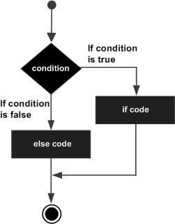
IF .. End if
Syntax
  IF condition THEN
  Statements;
  ELSE
  Statements;
  END IF;

Slide 78
Example: IF .. ELSE .. END IF
-- Block to demonstrate IF...ELSE...END IF
DECLARE
v_sr_id service_request.sr_id%TYPE;
v_sr_owner service_request.sr_owner%TYPE;
BEGIN
SELECT sr_owner INTO v_sr_owner FROM service_request
WHERE sr_id = v_sr_id;
IF v_sr_owner IS NULL THEN
DBMS_OUTPUT.PUT_LINE
(‘This service request is not yet assigned');
ELSE
DBMS_OUTPUT.PUT_LINE
(‘This service request is assigned’);
END IF;
DBMS_OUTPUT.PUT_LINE
('This line executes irrespective of the condition');
END;

Slide 79
Nested IF
Syntax
  IF condition THEN
  Statements;
      IF condition THEN
      Statements;
      ELSE
      Statements;
      END IF;
  ELSE
  Statements;
      IF condition THEN
      Statements;
      ELSE
      Statements;
      END IF;
  END IF;
If statement inside if statement
If statement inside else statement

Slide 80
Conditional Statement: Nested IF
DECLARE
firstNo NUMBER(5) := &firstNo;
secondNo NUMBER(5) := &secondNo;
BEGIN
IF firstNo IS NULL OR secondNo IS NULL THEN
DBMS_OUTPUT.PUT_LINE('Improper Input');
ELSE
IF firstNo = secondNo THEN
DBMS_OUTPUT.PUT_LINE ('The numbers are equal');
ELSE
IF firstNO > secondNo THEN
DBMS_OUTPUT.PUT_LINE ('The first no. is greater');
ELSE
DBMS_OUTPUT.PUT_LINE('The second no. is greater');
END IF;
END IF;
END IF;
END;

Slide 81
IF.. ELSIF.. END IF
Syntax
  IF condition1 THEN
  -- Executes when the condition 1 is true
  Statements;
  ELSIF condition2 THEN
  -- Executes when the condition 2 is true
  Statements;
  ELSIF condition3 THEN
  -- Executes when the condition 3 is true
  Statements;
  ELSE
  -- executes when the none of the above condition is true
  Statements;
  END IF;

Slide 82
Case Statement
Like IF statement, CASE statement selects one sequence of statements to execute.
However, to select the sequence, the CASE statement uses a selector rather than multiple Boolean expressions
A selector is an expression whose value is used to select one of several alternatives.

Slide 83
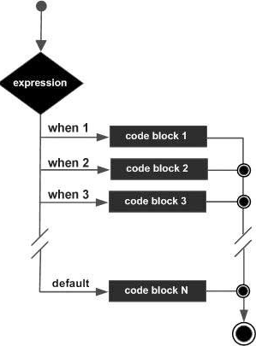
Conditional Statement: Case Statement
Syntax
CASE selector
  WHEN 'value1' THEN statements;
  WHEN 'value2' THEN statements;
  WHEN 'value3' THEN statements;
  ...
  ELSE statements;
  -- default case
END CASE;
Notes:
expression is optional. It is the value that you are comparing to the list of conditions. (ie: condition_1, condition_2, ... condition_n)
condition_1 to condition_n must all be the same datatype. Conditions are evaluated in the order listed. Once a condition is found to be true, the case statement will return the result and not evaluate the conditions any further.
result_1 to result_n must all be the same datatype. This is the value returned once a condition is found to be true
CASE selector
WHEN 'value1' THEN S1;
WHEN 'value2' THEN S2;
WHEN 'value3' THEN S3;
...
ELSE Sn; -- default case
END CASE;

Slide 84
Case Statement: Example
DECLARE
x NUMBER:=&num;
BEGIN
  CASE x
  WHEN 1 THEN
  dbms_output.put_line('1');
  WHEN 2 THEN
  dbms_output.put_line('2');
  WHEN 3 THEN
  dbms_output.put_line('3');
  WHEN 4 THEN
  dbms_output.put_line('4');
  WHEN 5 THEN
  dbms_output.put_line('5');
  ELSE
  dbms_output.put_line('Greater than 5');
  END CASE;
END;

Slide 85

Searched CASE statement
The searched CASE statement has no selector, it is WHEN clause that contains search condition to give Boolean values.
Syntax:
CASE
  WHEN selector = 'value1' THEN
  statements;
  WHEN selector = 'value2' THEN
  statements;
  ...
  ELSE
  statements;
  -- default case
END CASE;

Slide 86
Searched CASE statement: Example
  DECLARE
  grade char(1) := 'B';
  BEGIN
    CASE
    WHEN grade = 'A' THEN dbms_output.put_line('Excellent');
    WHEN grade = 'B' THEN dbms_output.put_line('Very good');
    WHEN grade = 'C' THEN dbms_output.put_line('Well done');
    WHEN grade = 'D' THEN dbms_output.put_line('You passed');
    WHEN grade = 'F' THEN dbms_output.put_line('Better try again');
    ELSE
    dbms_output.put_line('No such grade');
    END CASE;
  END;

Slide 87
PL/SQL Loop Control Structures
LOOP Statements
    Simple Loops
    WHILE Loops
    FOR Loops

Slide 88
LOOP Statements
Simple Loops
Note: Add EXIT statement to exit from the loop
WHILE Loops
Note: Condition is evaluated before each iteration of the loop
  LOOP
  Sequence_of_statements;
  END LOOP;
  WHILE condition
  LOOP
  Statements;
  END LOOP;

Slide 89
LOOP Statement: Example
DECLARE
v_i NUMBER(2) := 1;
BEGIN
LOOP
DBMS_OUTPUT.PUT_LINE(‘Value : ‘|| v_i);
EXIT WHEN v_i = 10;
v_i:=v_i+1;
END LOOP;
END;

Slide 90
WHILE Loop: Example
DECLARE
v_i NUMBER(2) := 1;
BEGIN
WHILE ( v_i <= 10 )
LOOP
DBMS_OUTPUT.PUT_LINE(‘Value : ‘|| v_i);
v_i:=v_i+1;
END LOOP;
END;

Slide 91
FOR Loops
  FOR counter IN [REVERSE] low_bound .. high_bound
  LOOP
  Statements;
  END
Notes:
Eg # 1
The following loop will print the number series from 1 to 10.
BEGIN
FOR v_count IN 1 .. 10
LOOP
DBMS_OUTPUT.PUT_LINE(‘Count is :’ || v_count);
END LOOP;
END;
Eg # 2
The following loop will print the number series from 10 to 1.
BEGIN
FOR v_count IN REVERSE 1 .. 10
LOOP
DBMS_OUTPUT.PUT_LINE(‘Count is :’ || v_count);
END LOOP;
END;

Slide 92
FOR Loop: Example
BEGIN
FOR v_i IN 1..10
/* The LOOP VARIABLE v_i of type BINARY_INTEGER is declared automatically */
LOOP
DBMS_OUTPUT.PUT_LINE(‘Value : ‘|| v_i);
END LOOP;
END;

Slide 93
For Loop with EXIT condition
DECLARE
myNo NUMBER(5):= &myno;
counter NUMBER(5):=1;
BEGIN
FOR i IN 2..myNo-1
LOOP
counter:= counter+1;
EXIT WHEN myNo mod i = 0;
END LOOP;
IF counter = myNo-1 THEN
DBMS_OUTPUT.PUT_LINE( 'The given
number is prime' );
ELSE
DBMS_OUTPUT.PUT_LINE('The given number is not
a prime number' );
END IF;
END;

Slide 94
Good Coding Practices

Slide 95
Good Coding Practices
While writing your code, ensure on the following:
  Readability
    Code should be simple to read, even without comments
    Variable names should be expressive and unambiguous
  Ease of Maintenance, Testing & Debugging
  A consistent programming style which enhances Readability
  PL/SQL allows us to write very readable, self-documenting and easily maintained code

Slide 96
Good Coding Practices
Anchored Declarations to Explicit data type references:
    %TYPE for Scalar Structures
    %ROWTYPE for Composite Structures
To improve code performance make use of bind variables

Slide 97
Use of Bind Variables
Avoids unnecessary Parsing
A key to improved Code Performance
PL/SQL code improves by several orders of magnitude, depending on the Type and Size of data

Slide 98
Control Structures
Select Control Structures carefully
Multiple Conditional Statements
    IF quantity <= 5 THEN
    Shipping_method := standard_shipping;
    END IF;
    IF quantity > 5 THEN
    Shipping_method := expedited_shipping;
    END IF;
Replacing IF with ELSIF
    IF quantity <= 5 THEN
    Shipping_method := standard_shipping;
    ELSIF quantity > 5 THEN
    Shipping_method := expedited_shipping;
    END IF;

Slide 99
Summary
In this session, we have covered,
    Oracle PL/SQL block structure
    Embedding SELECT and DML statements inside PL/SQL block
    Oracle PL/SQL Control Structures

Slide 100
Thank You

